Slide 1


Capstone Project-4
Book Recommendation system
Team Members 1)Sachin S Panchal 2) ArunTeja Lonka

Slide 2








Contents
Introduction
Exploratory Data Analysis
Data Processing
Model To be Used in the project
Recommendation Predictions
Results & Conclusions
Challenges Faced

Slide 3

Problem Statement
Recommender systems are really critical in some industries as they can generate a huge amount of income when they are efficient or also be a way to stand out significantly from competitors. The main objective is to create a book recommendation system for users based on popularity and user interests
In a very general way, recommender systems are algorithms aimed at suggesting relevant items to users (items being movies to watch, text to read, products to buy, or anything else depending on industries).

Slide 4
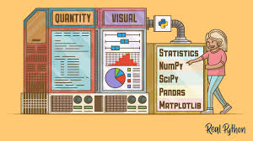
Data Summary:
We are using Book-Crossing dataset to train and test our recommendation system. It contains 1.1 million ratings of 270,000 books by 90,000 users. The ratings are on a scale from 1 to 10. The Book-Crossing dataset comprises 3 files.
In the users dataset we have the following feature variables.
● User-ID (unique for each user)
● Location (contains city, state and country separated by commas)
● Age
In the books dataset we have the following feature variables.
●ISBN (unique for each book)
●Book-Title
●Book-Author
●Year-Of-Publication
●Publisher
●Image-URL-S
●Image-URL-M
●Image-URL-L
In the ratings dataset we have the following feature variables.
●User-ID
●ISBN
●Book-Rating

Slide 5
Flow of the Project
Load the Data
Data Pre-processing
EDA
Algorithms Implemented
Required Recommendation search Engine
Conclusions

Slide 6
Data Pre-processing
The dataset consists of three tables; Books, Users, and Ratings. Data from all three tables are cleaned and pre-processed separately as defined below briefly:
For Books Dataset:
Drop all three Image URL features.
Check for the number of null values in each column. There comes only 3 null values in the table. Replace these three empty cells with ‘Other’.
Check for the unique years of publications. Two values in the year column are publishers. Also, for three tuples name of the author of the book was merged with the title of the book. Manually set the values for these three above obtained tuples for each of their features using the ISBN of the book.
Convert the type of the years of publications feature to the integer.
By keeping the range of valid years as less than 2022 and not 0, replace all invalid years with the mode of the publications that is 2002.
Upper-casing all the alphabets present in the ISBN column and removal of duplicate rows from the table.

Slide 7

Data Pre-processing
For Users Dataset:
Check for null values in the table. The Age column has more than 1 lakh null values.
Check for unique values present in the Age column. There are many invalid ages present like 0 or 244.
By keeping the valid age range of readers as 10 to 80 replace null values and invalid ages in the Age column with the mean of valid ages.
The location column has 3 values city, state, and country. These are split into 3 different columns named; City, State, and Country respectively. In the case of null value, ‘other’ has been assigned as the entity value.
Removal of duplicate entries from the table.

Slide 8

Data Pre-processing
For Ratings Table:
Check for null values in the table.
Check for Rating column and User-ID column to be an integer.
Removal of punctuation from ISBN column values and if that resulting ISBN is available in the book dataset only then considering else drop that entity.
Upper-casing all the alphabets present in the ISBN column.
Removal of duplicate entries from the table.

Slide 9
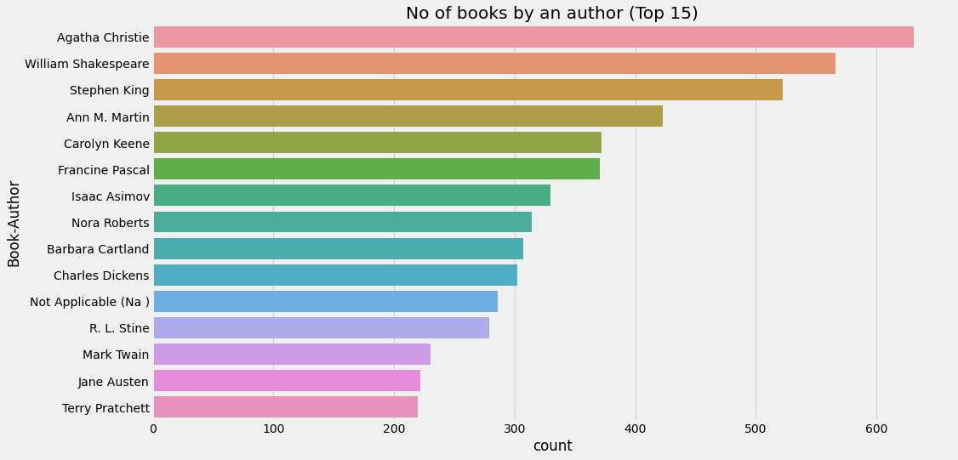
EDA

Slide 10
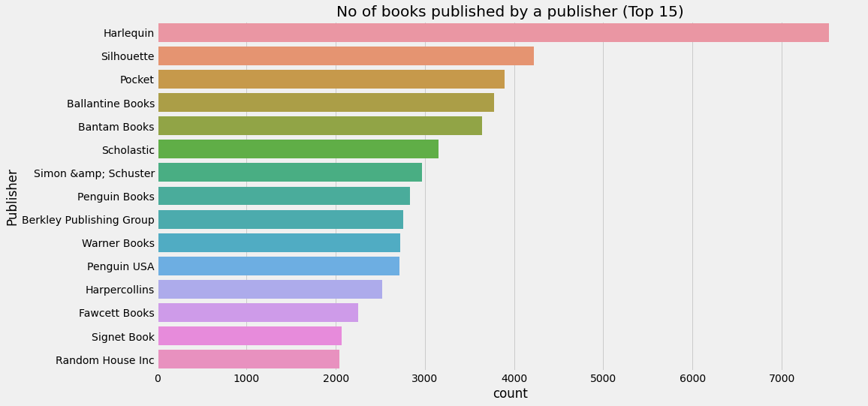
EDA

Slide 11
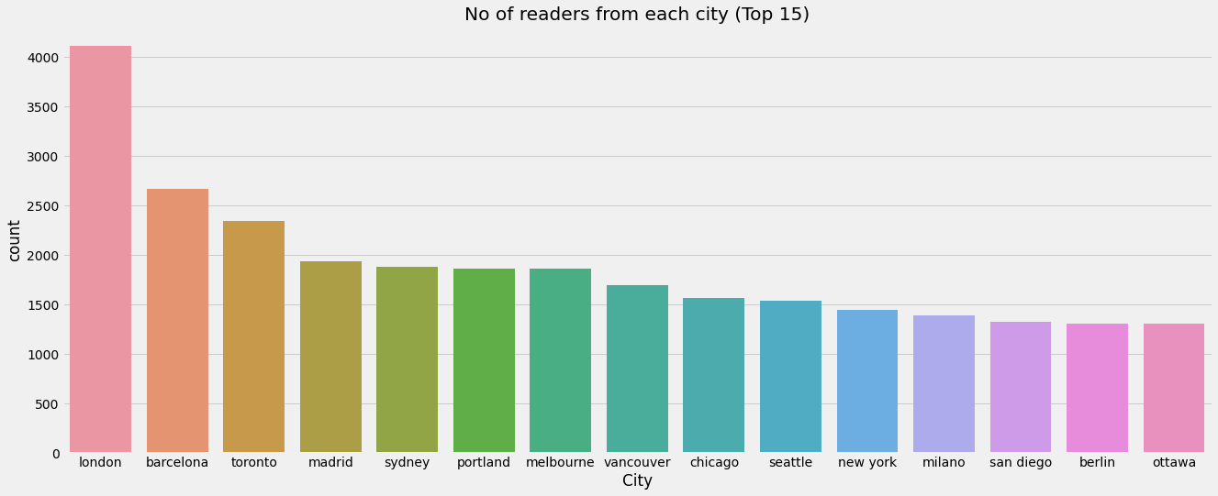
EDA

Slide 12
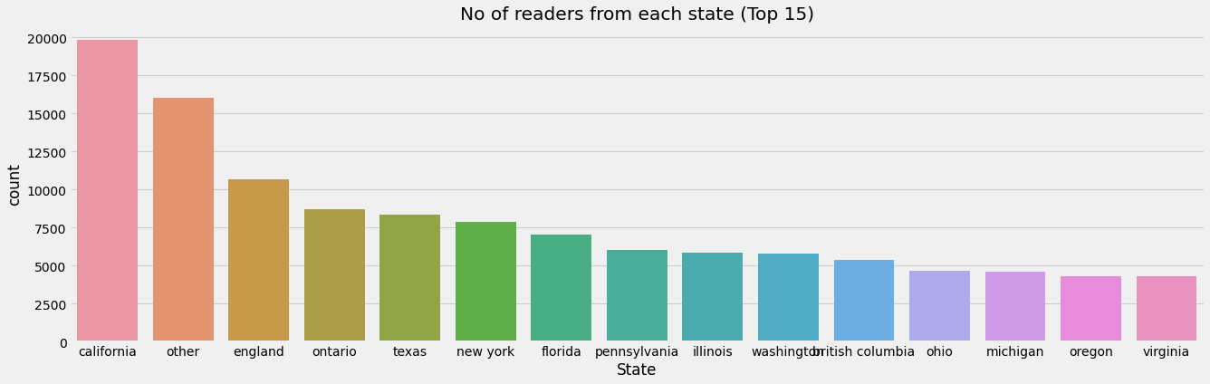
EDA

Slide 13
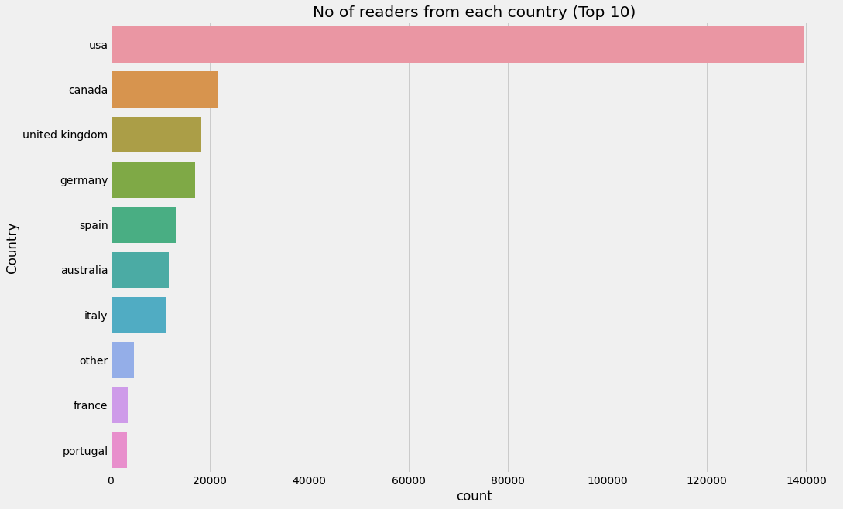
EDA

Slide 14
Algorithms Implemented:
Popularity Based (Top In whole collection)
Books by same author, publisher of given book name
Average Weighted Ratings
User - Item Collaborative Filtering
Correlation Based Recommendation System
Nearest Neighbours Based recommendation System
SVD(Singular Value Decomposition) Based recommendation System
Content Based recommendation System
Hybrid Approach (Content + Collaborative) Using percentile

Slide 15
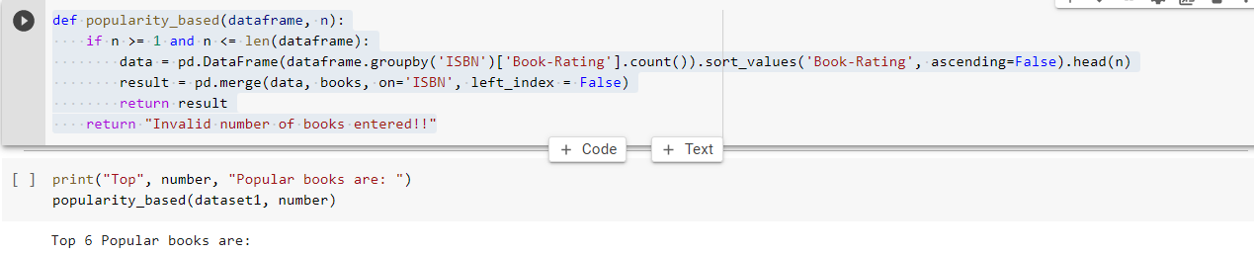
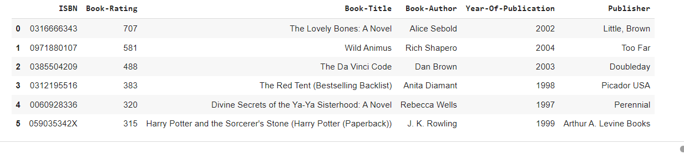
Popularity Based (Top In whole collection)
Now let's try to build our first recommendation system based on popularity. These systems check about the product or movie which are in trend or are most popular among the users and directly recommend those.

Slide 16

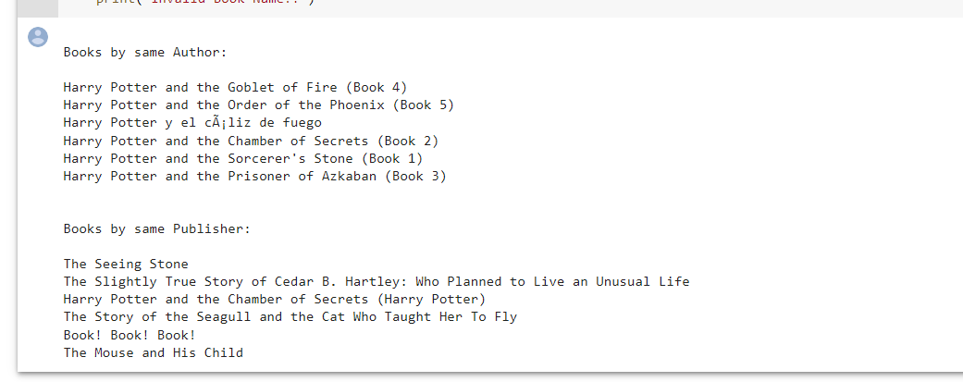
Books by same author, publisher of given book name
Recommendation
Enter a book name:
Harry Potter and the Sorcerer's Stone (Harry Potter (Paperback))
Enter number of books to recommend: 6

Slide 17
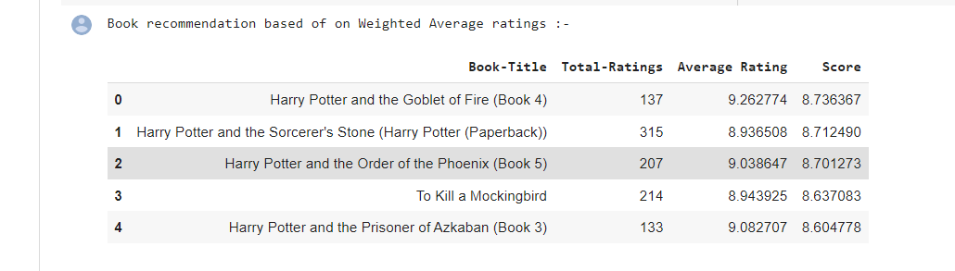
Average Weighted Rating Based Recommendations:
We have calculated the weighted score using the below formula for all the books and recommended the books with the highest score.
score= t/(t+m)∗a + m/(m+t)∗c
where, t represents the total number of ratings received by the book, m represents the minimum number of total ratings considered to be included a represents the average rating of the book and, c represents the mean rating of all the books.

Slide 18
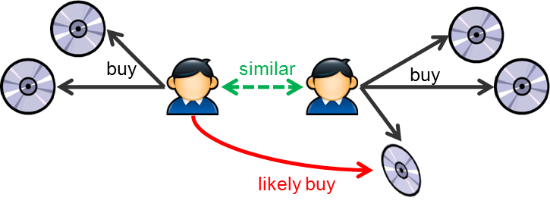
Collaborative Filtering Recommendation System works by considering user ratings and finds cosine similarities in ratings by several users to recommend books. To implement this, we took only those books' data that have at least 50 ratings in all.
Collaborative Filtering

Slide 19
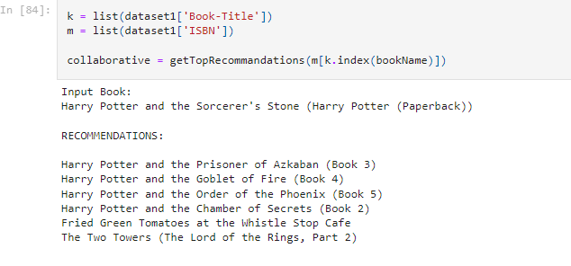






User - Item Collaborative Filtering
Your Input book is…..
Your Recommendations are……..

Slide 20
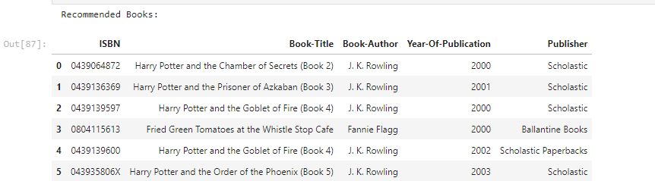
Correlation Based Recommendation System
For this model, we have created the correlation matrix considering only those books which have total ratings of more than 50. Then a user-book rating matrix is created. For the input book using the correlation matrix, top books are recommended.
Your Input book is…..

Slide 21
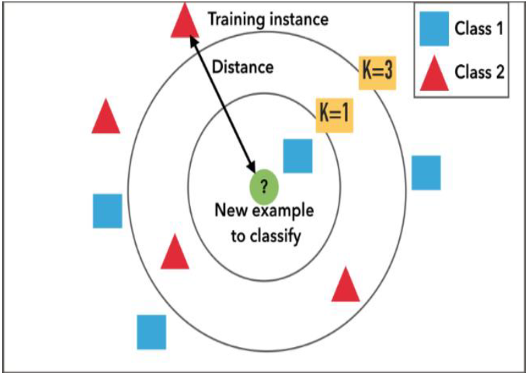
KNN (k-Nearest Neighbours) as an algorithm seems to be inspired from real life. The full k-Nearest Neighbours algorithm works much in the way some of us ask for recommendations from our friends. First, we start with people whose taste we feel we share, and then we ask a bunch of them to recommend something to us. If many of them recommend the same thing, we deduce that we’ll like it as well. When KNN makes inference about a movie, KNN will calculate the “distance” between the target book and every other book in its database, then it ranks its distances and returns the top K nearest neighbour movies as the most similar book recommendations.
Nearest Neighbours Based recommendation System

Slide 22
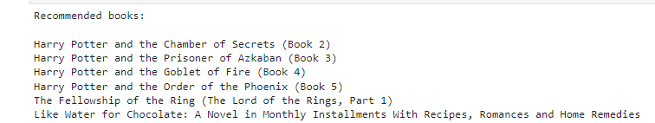


Your Recommendations are……..
Nearest Neighbours Based recommendation System
Your Input book is…..

Slide 23
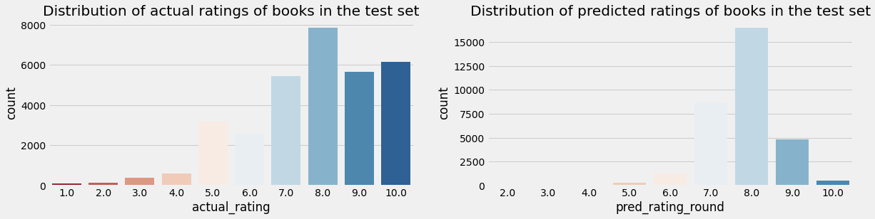
SVD Based recommendation System
The SVD(Singular Value Decomposition) is used as a collaborative filtering technique. It uses a matrix structure where each row represents a user, and each column represents an item. The elements of this matrix are the ratings that are given to items by users.

Slide 24
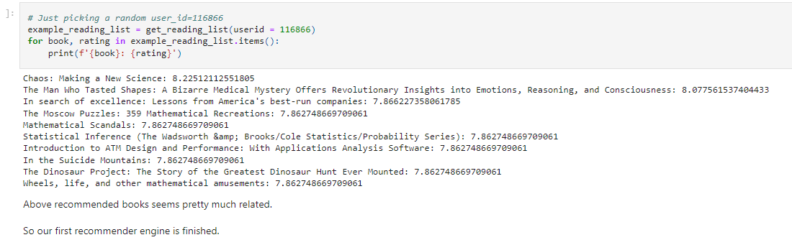
SVD Based recommendation System

Slide 25
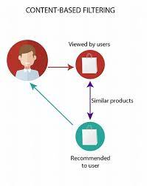
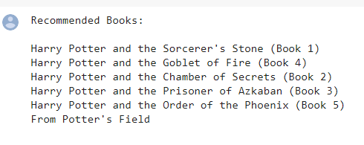

Content Based recommendation System
This system recommends books by calculating similarities in Book Titles. For this, TF-IDF feature vectors were created for unigrams and bigrams of Book-Titles; only those books' data has been considered which are having at least 80 ratings.

Slide 26
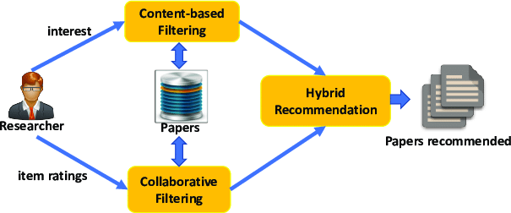
Hybrid Approach (Content + Collaborative)
A hybrid recommendation system is a special type of recommendation system which can be considered as the combination of the content and collaborative filtering method.
A percentile score is given to the results obtained from both content and collaborative filtering models and is combined to recommend top n books.
Netflix is a good example of the use of hybrid recommender systems.

Slide 27
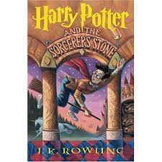
Recommendations
Hybrid Approach (Content + Collaborative)
Your Input book is…
Your Recommendations are…

Slide 28
Results & Conclusions
Recommendation system is unturned to exist in the e-commerce businesses with the help of collaborative or content-based filtering to predict different items and yes, users are most satisfied with the products recommended to them.
While performing Exploratory Data Analysis we observed that almost 42% of readers with age-34 read more books compared to other age group of readers.
Books with publication years are somewhat between 1950 - 2005.
Also the readers mostly give 8 ratings(on scale 1-10) to books followed by 10 and 7.
There are more readers from locations London,england,united kingdom,toronto,ontario,canda compare to other locations.
KNN model gives good recommendation for books.

Slide 29
Results & Conclusions
SVD(Singular value decomposition) with best accuracy on test data which give stronger recommendations. These results show that our proposed system can remove boring books from the recommendation list more efficiently.
Popularity based recommendation systems helpful to new users. we don't have data about new user so here popularity based recommendations are more useful
Content based recommendation systems also performing well , they are given more accurate predictions.
A hybrid recommendation system was built using the combination of both content-based filtering and collaborative filtering systems. A percentile score is given to the results obtained from both content and collaborative filtering models and is combined
Most of the companies like Netflix , Amazon are using Hybrid recommendation search engines ,because they are more efficient..
In Our case also Hybrid approach gives best recommendations...
Finally this was nice Project to Work .I think i build a most efficient recommendation system

Slide 30

Challenges Faced
• Understanding the metric for evaluation was a challenge as well.
• Decision making on missing value imputations quite challenging.
• Handling of sparsity was a major challenge.

Slide 31

Refences and links
References:
Alma better
Analytics Vidhya
Kaggle
Quora
Stack over flow
Links for the code:
Git hub link:
Google Drive link:

